Slide 1
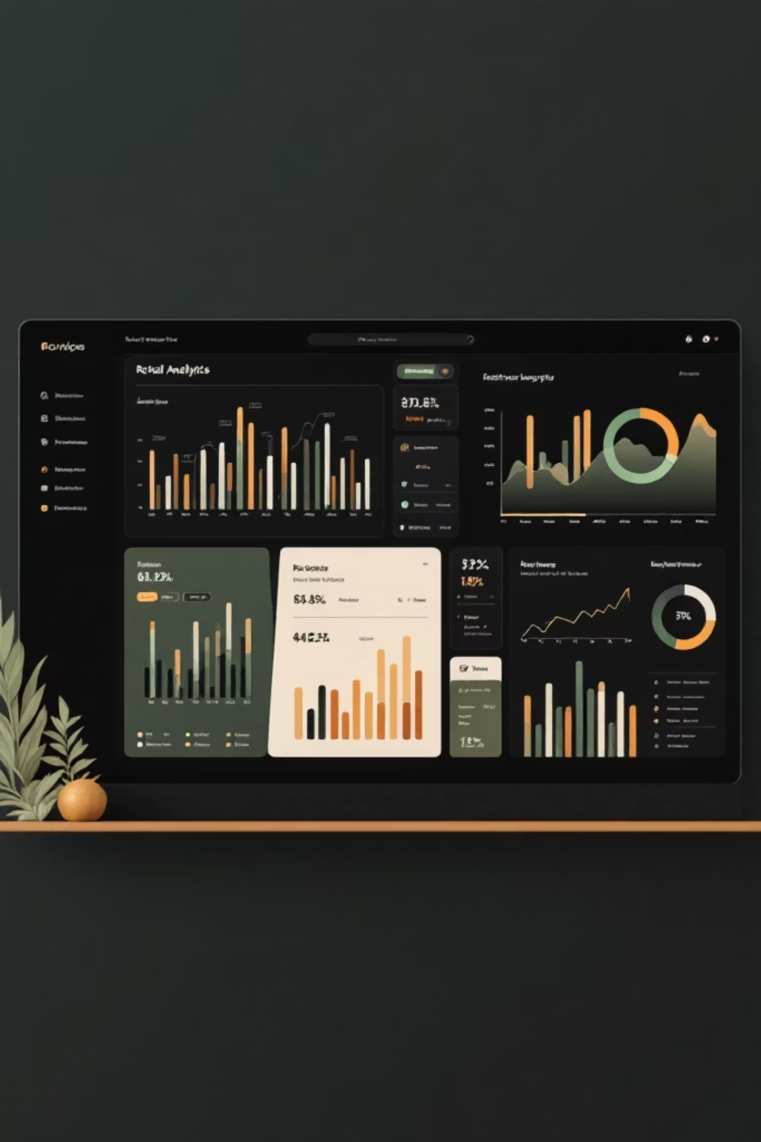
Customer Shopping Behavior Analysis
Uncovering insights from 3,900 purchases to guide strategic business decisions

Slide 2
DATASET OVERVIEW
The Foundation
Dataset Scale
3,900 transactions analyzed across 18 key features
18
37
Data Points
Missing Values
Customer demographics, purchase details, shopping behavior
Only in Review Rating column

Slide 3

PYTHON ANALYSIS
Data Preparation & Cleaning
01
Data Loading & Exploration
Imported dataset, checked structure with df.info() and summary statistics
02
Missing Data Handling
Imputed Review Rating nulls using median by product category
03
Feature Engineering
Created age_group bins and purchase_frequency_days columns
04
Database Integration
Connected to PostgreSQL for structured SQL analysis

Slide 4
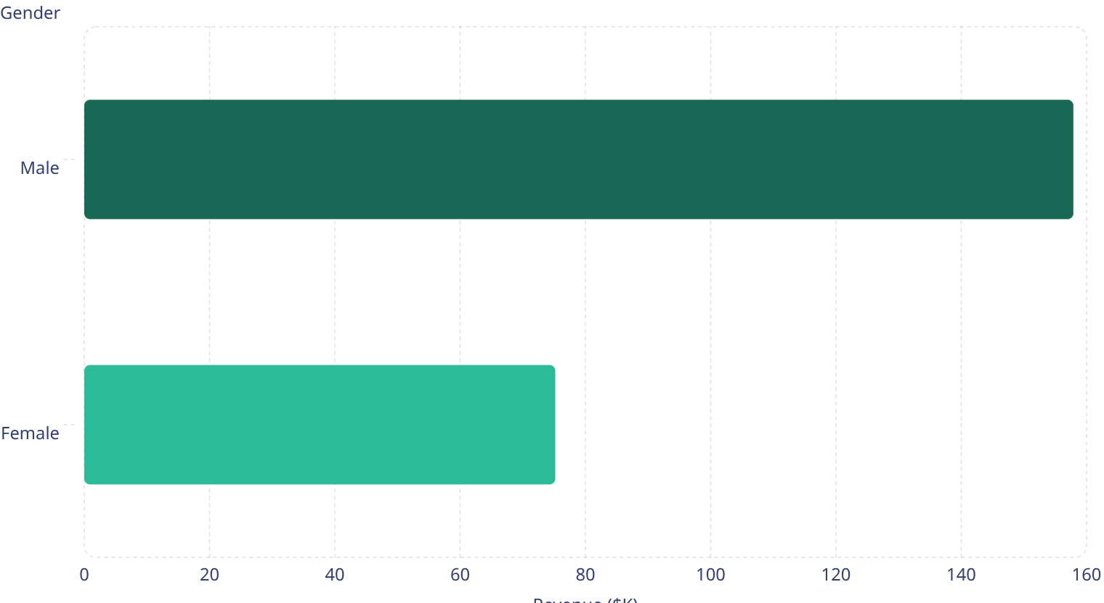
SQL INSIGHTS
Revenue by Gender
Key Finding
Male customers generate 2.1x more revenue than female customers
Total revenue analyzed: $233,081

Slide 5
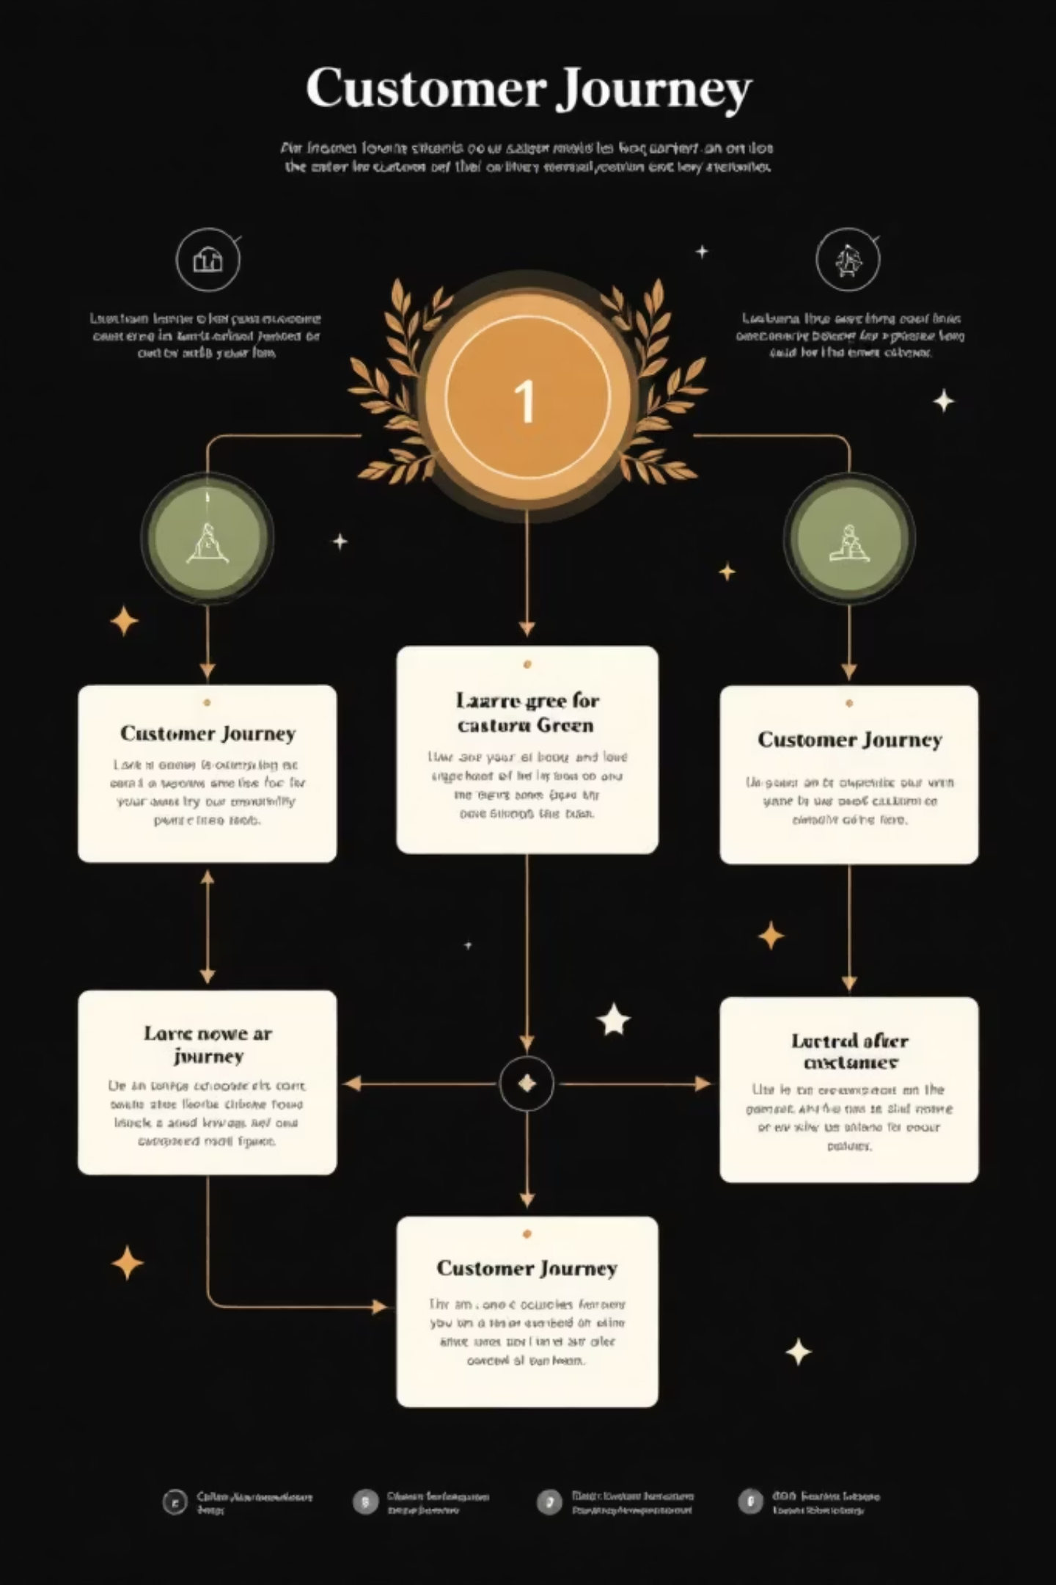
Customer Segmentation Insights
Loyal Customers
Returning
New
701 customers
83 customers
Growth opportunity segment
Fresh acquisition potential
3,116 customers
Largest segment driving repeat business

Slide 6

PRODUCT PERFORMANCE
Top-Rated Products
1
Gloves
3.86 average rating
2
Sandals
3.84 average rating
3
Boots
3.82 average rating
4
Hat
3.80 average rating
5
Skirt
3.78 average rating

Slide 7
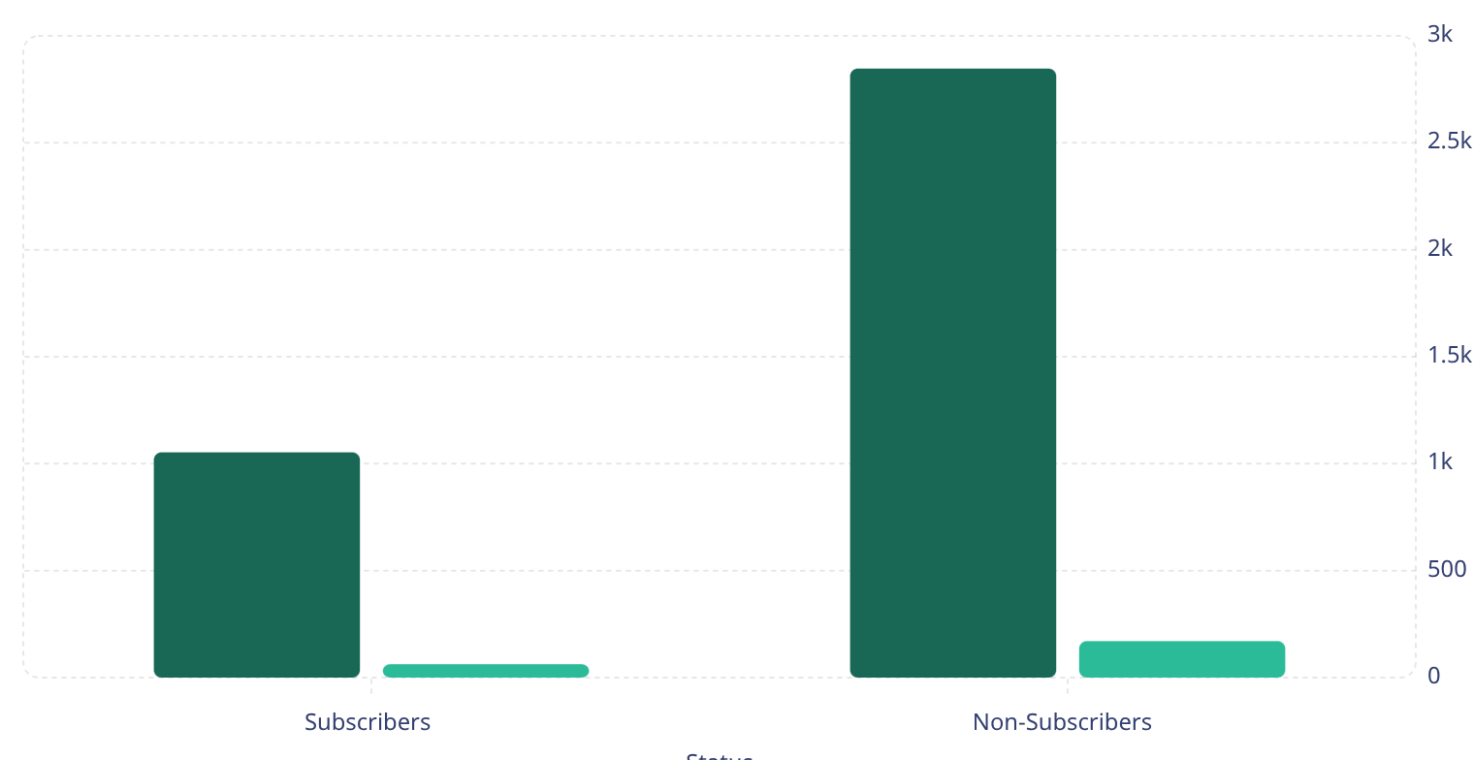
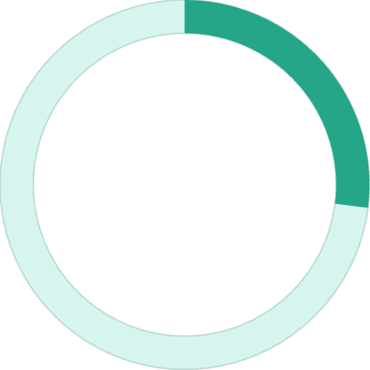
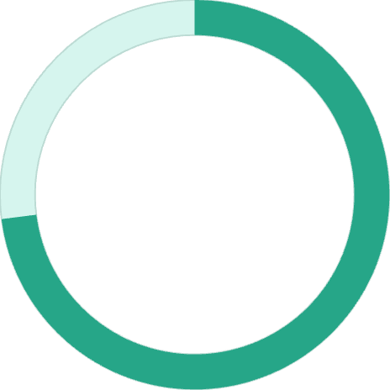
Subscription vs. Non-Subscription
Customers
Revenue ($K)
27%
73%
Subscription Rate
Non-Subscribers
1,053 of 3,900 customers
Untapped conversion opportunity
Average spend nearly identical: $59.49 vs $59.87

Slide 8
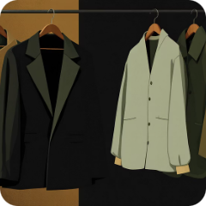


POWER BI DASHBOARD
Interactive Visual Analytics
Clothing Dominates
Accessories Strong
Young Adults Lead
$100K revenue, 1,800 sales
$70K revenue, 1,200 sales
Highest revenue by age group

Slide 9
KEY FINDINGS
Critical Insights
Discount Dependency
Shipping Preferences
High-Value Discounters
Repeat Buyer Behavior
Hat leads at 50% discount rate, followed by Sneakers at 49.66%
Express shipping users spend $2 more on average ($60.48 vs $58.46)
839 customers used discounts but still spent above average
958 subscribers are repeat buyers; 2,518 non-subscribers also repeat

Slide 10






RECOMMENDATIONS
Strategic Action Plan
Boost Subscriptions
Promote exclusive benefits to convert 73% non-subscribers
Loyalty Programs
Reward repeat buyers to grow loyal segment
Review Discounts
Balance sales boosts with margin control
Targeted Marketing
Focus on high-revenue age groups and express shippers

